Slide 1
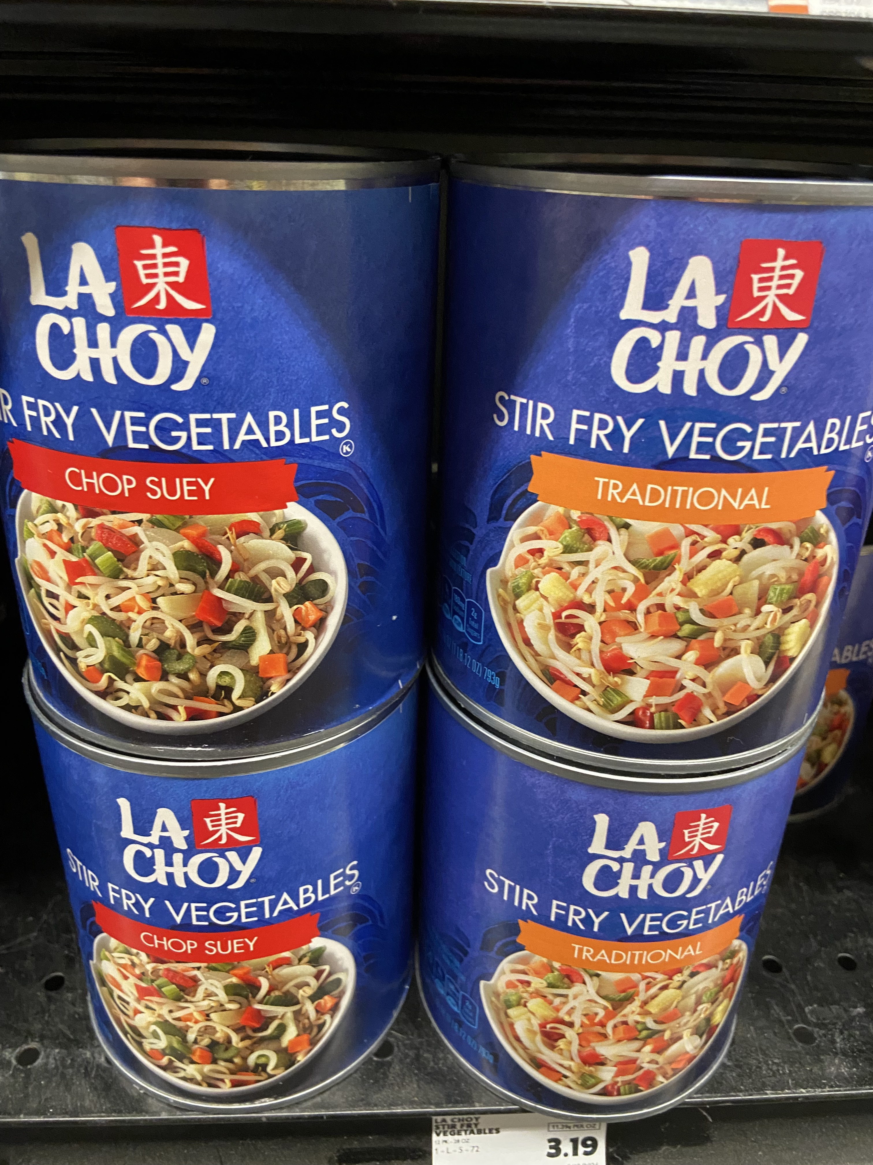
Week 5 by Wed. read: “Beefeaters,” Sekhon “Toll House Cookies,” Nguyen “If You Are What You Eat, Then What Am I?,” Kothari “The Garden,” Thao view media: Bao, Shi Today: What did you have for dinner last night?

Slide 2
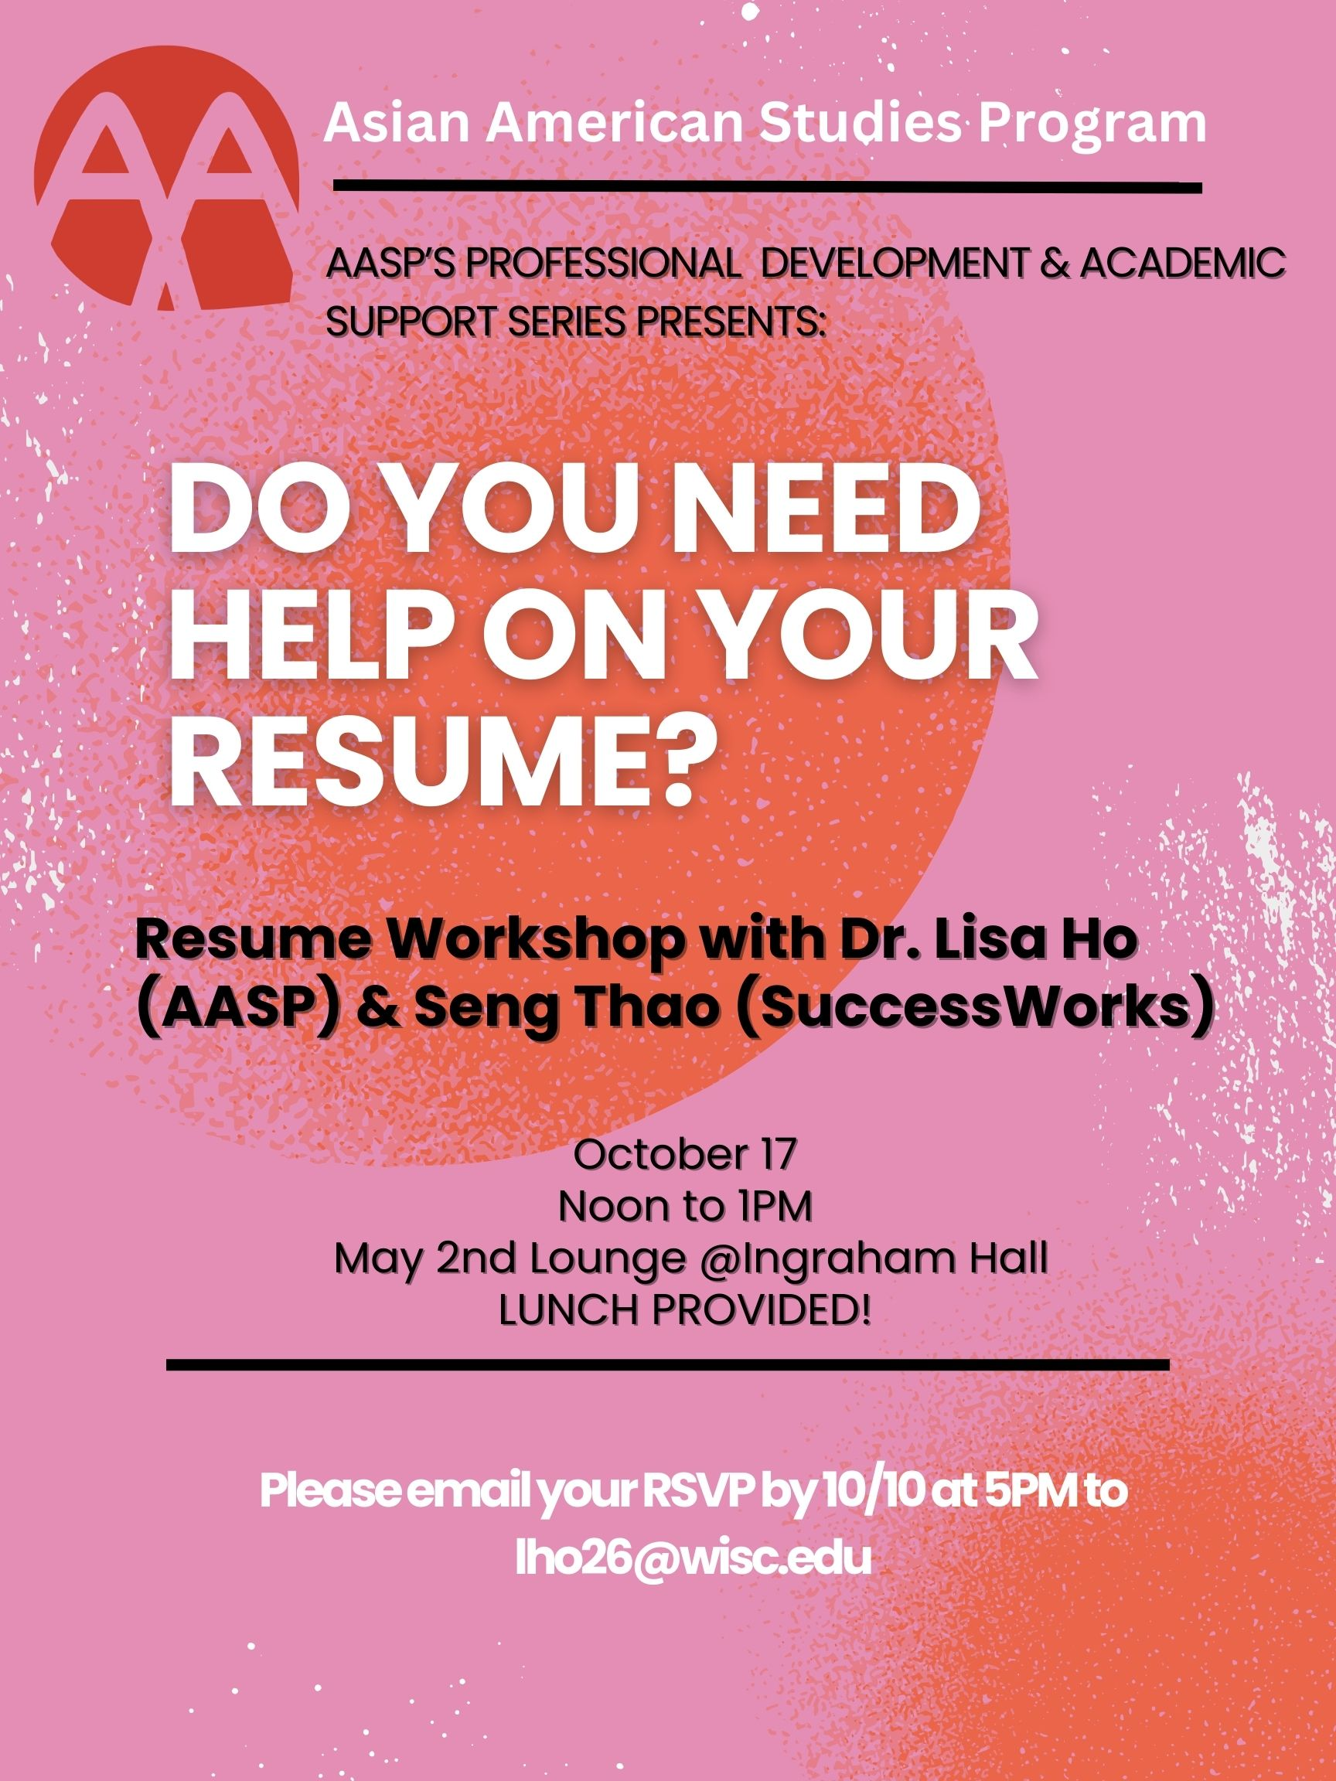

Slide 3
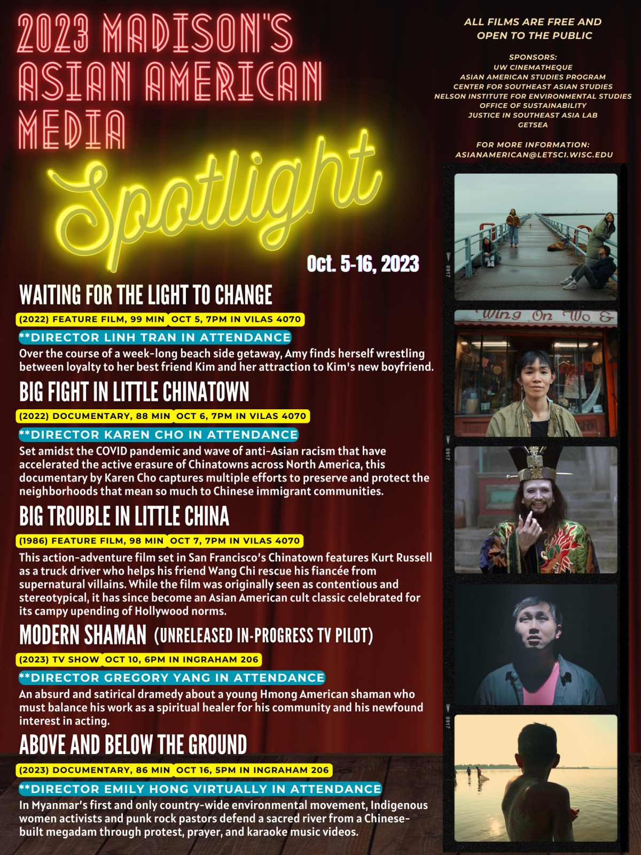
Poster is under next week’s module

Slide 4

Today on the politics of food:
Foundation:
“cuisine driven multiculturalism”
Adaptation vs. authenticity
and
Complications:
“food pornography”
and
“food colonialism”

Slide 5
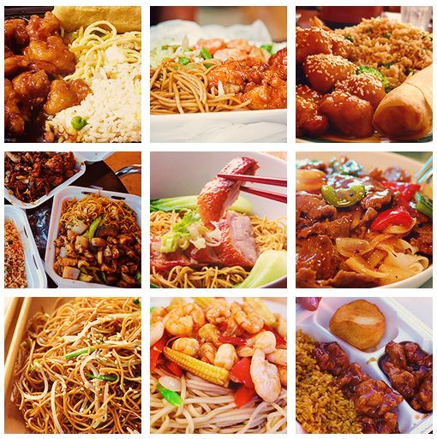
Opening Exercise 2 min.
Turn to at least 3 people sitting next to you:
Share with them what you had for dinner.
To think about for section:
Your answer may appear to be a neutral statement about individual choice. Is it?
What are some of the systemic structures underlying your last night’s dinner?

Slide 6
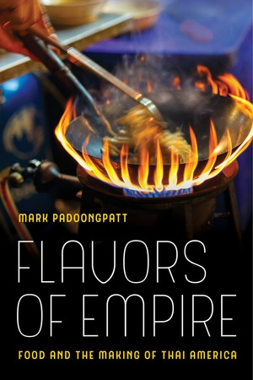
Mark Padoongpatt from Flavors of Empire: Food and the Making of Thai America:
“[C]uisine driven multiculturalism worked to naturalize the presence of Thais in the food and restaurant industry and thus their social position in U.S. society. In other words, as Thai cuisine flourished, so too did the idea that Thais possessed a cultural or natural ability to cook.
As consumers celebrated Thai food, the social, political, and economic structures that pushed Thais into the food industry and service section economy in the first place went ignored” (14).

Slide 7
Is this Chinese food?
Why or why not?
Volunteers [with no food allergies]??
Taste test:
La Choy’s canned chop suey*
[*contains msg]

Slide 8


Slide 9
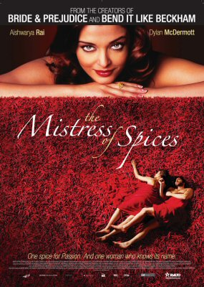
“Food Pornography,” Sau-ling Wong
Being a “food pornographer” involves
“making a living by exploiting the ‘exotic’ aspects of one’s ethnic foodways . . .
exaggerating one’s otherness in order to gain a foothold in a white-dominated social system. . . .
[S]uperficially, food pornography appears to be a promotion, rather than a vitiation or devaluation, of one’s ethnic identity.”

Slide 10
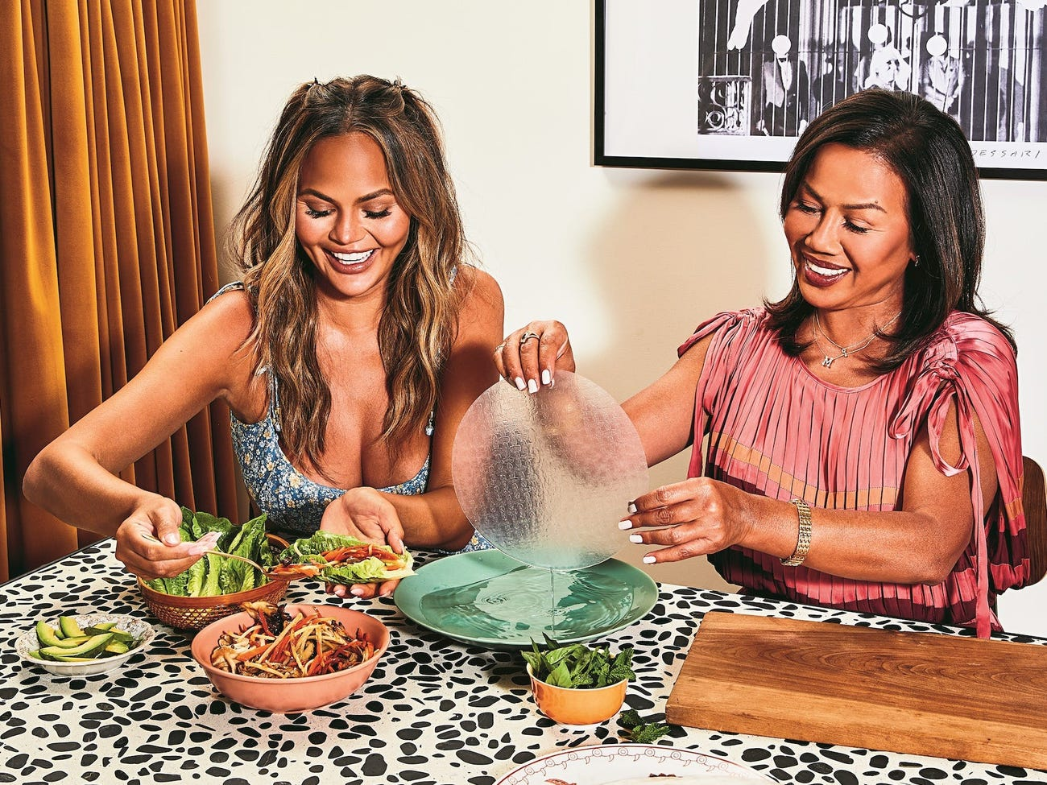
Mark Padoongpatt:
“But cuisine driven multiculturalism also benefited Thais in Los Angeles. Thai Americans saw their exotification and perceived natural ability to cook as positive representations and participated in creating and perpetuating them.
Being seen as exotic meant being unique and different, and in a consumer culture, that often meant more customers.
Thai Americans kept labor and gender exploitation behind the kitchen door hidden to prevent negative images of the Thai community from spreading in a way that might undermine those positive representations” (140).
Pepper and Chrissy Teigen
Jenny Huang, The Pepper Thai Cookbook

Slide 11
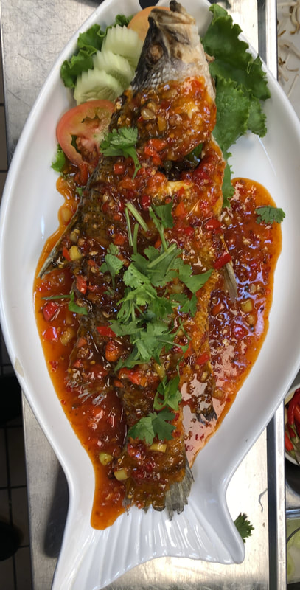
From “Let’s Eat Thai,” Heldke, p. 395
“I had come to see my adventure cooking and eating as strongly motivated by an attitude bearing deep connections to Western colonialism and imperialism . . . .
the attitude of various nineteenth-and twentieth-century European painters, anthropologists, and explorers who set out in search of ever ‘newer,’ every more ‘remote’ cultures they could co-opt, borrow from freely and out of context, and use as the raw material for their own efforts at creation and discovery.”

